Slide 1
Automated Annotation of Source Code for ML Applications
Robby Rice – Digital Content Coordinator Maxwell Sutcliffe – Client Communication Coordinator Gavin Canfield – Quality Control Amon McAllister – Individual Component Design Tanner Dunn – Agile Framework Organizer

Slide 2
Introduction
By Robby, Max, Amon, Gavin and Tanner

Slide 3
Problem Statement
PhD advisor Arushi is studying code to code machine learning
Currently a black box
Wants to study connections

Slide 4
Overview
Dataset
Primarily – Dataset for code syntax with labeled snippets of code
{"level":"mid","id":8,"label":"FieldDeclaration","token":"int x;"}
Possible open-source tool
Dataset Creation Tool

Slide 5
Overview II
Machine Learning Results
Secondarily - machine Learning using NLP techniques
Train a model on Dataset
Evaluate the model
Token Classifier to predict labels for code snippets

Slide 6
Annotation Overview
Load File(s)
AST Creation
Custom Visitor
Output Json
Apply Labels

Slide 7
ML-Pipeline Overview
Load Data Set
Tokenize
Model Selection
Training
Token Classifier
Publish Model
Evaluation

Slide 8
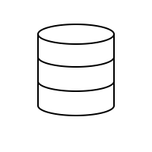
Terminology
Level: Can be 1 of 2 things,
Depth: The chosen depth in an AST tree. Used depth to create a dataset.
High, Low, Mid – the three categories we used to group our labels. Addition vs class declaration
Label: A string describing the token
Token: piece of code syntax represented as a string

Slide 9
Implementation Architecture

Slide 10
Data Creation Tool
Purpose: Used to create AST and do the preprocessing needed for datasets
Driver Code: Specified dataset characteristics
Levels: High, Low, Mid
Visitors: Various ways to traverse the AST tree

Slide 11
Datasets
Levels: High, Low, Mid vs Depth
High, Low, Mid: We ambiguously categorized labels at either medium, low and high level.
Depth: This dataset grouped every node at a certain depth in the AST tree.
Problems:
Unsystematic approach for high mid low dataset
Unknowable depth before tree is created.

Slide 12
ML Application
For our ML Model we decided to work with Hugging Face
open-source platform for natural language processing
provides a suite of tools and libraries for building, training, and deploying state-of-the-art machine learning models
Easily Save and Evaluate Trained Model with tokenizer
Utilized Jupyter Notebook to implement Hugging Face Model
In Progress: HPC to train the model on the entire dataset

Slide 13
Tools
Dataset
Java snippets
Java program
JavaParser – AST creation
JSON to store results
Machine Learning
Took JSON -> Python
Hugging Face

Slide 14
Work Accomplishments

Slide 15
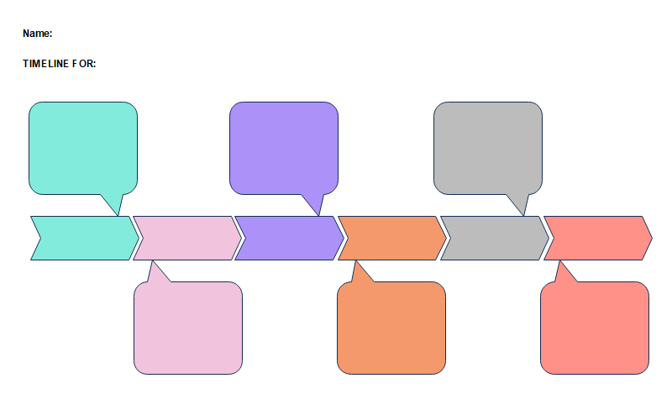
Timeline Accomplishments
January
March
April
Dataset Tool Finished
Dataset Created ✔️
ML Pipeline

Slide 16
Key Contributions

Slide 17
Dataset Team
Gavin
Led work on modular dataset tool
Experience with Abstract Syntax Trees
Robby
Created initial dataset tool
Did research last semester on dataset creation tool/ libraries
Max
Led preprocessing of dataset
Contributed heavily to all steps of dataset creation

Slide 18
Machine Learning Team
Tanner
Led work on setting up initial Hugging Face Model(NLP Chunking)
Data Preprocessing for our Dataset
Amon
Led work on Converting initial model to work on our Dataset
Tokenizer
Cluster

Slide 19
Challenges and Solutions

Slide 20
Dataset Challenges
Defining labels
Lack of knowledge on how to approach this problem
Struggling with libraries
Settled on JavaParser
What is our "why?"
Glorified compiler/pre-processer

Slide 21
Machine Learning Challenges
Model Complexity
Training time on full dataset
Tokenizer
HPC Cluster Access

Slide 22
Future Work

Slide 23
Future Work
Hand off project to Grad student
Documentation!
More ML insights
Higher understanding of dataset and goals of project
Open-source our tool

Slide 24
Conclusion

Slide 25
Conclusion
Got a dataset
Understanding + quality
Explored initial ML insights
Many of us gained a ton of knowledge about ML
World of opportunity in ML
Relation to real-world projects?
+

Slide 26
Questions?

